Slide 1

Sinus Lift at Time of Implant Placement
David A. Walls, DDS, MD

Slide 2
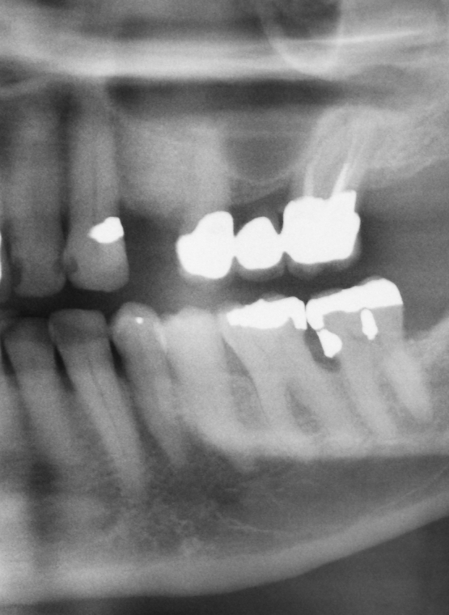
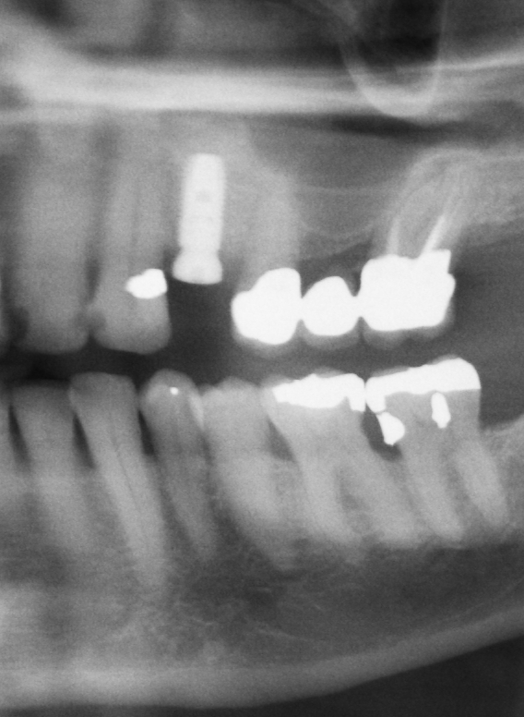
Implant #12
Preoperative Xray
Postperative Xray

Slide 3
Modified Sinus Lift
Allows for sinus augmentation without making an incision.
Allows for sinus augmentation at the time of implant placement.
Allows for a single surgical site instead of two as required for traditional open sinus augmentation.

