Slide 1

Mandibular Tori
David A. Walls, DDS, MD

Slide 2
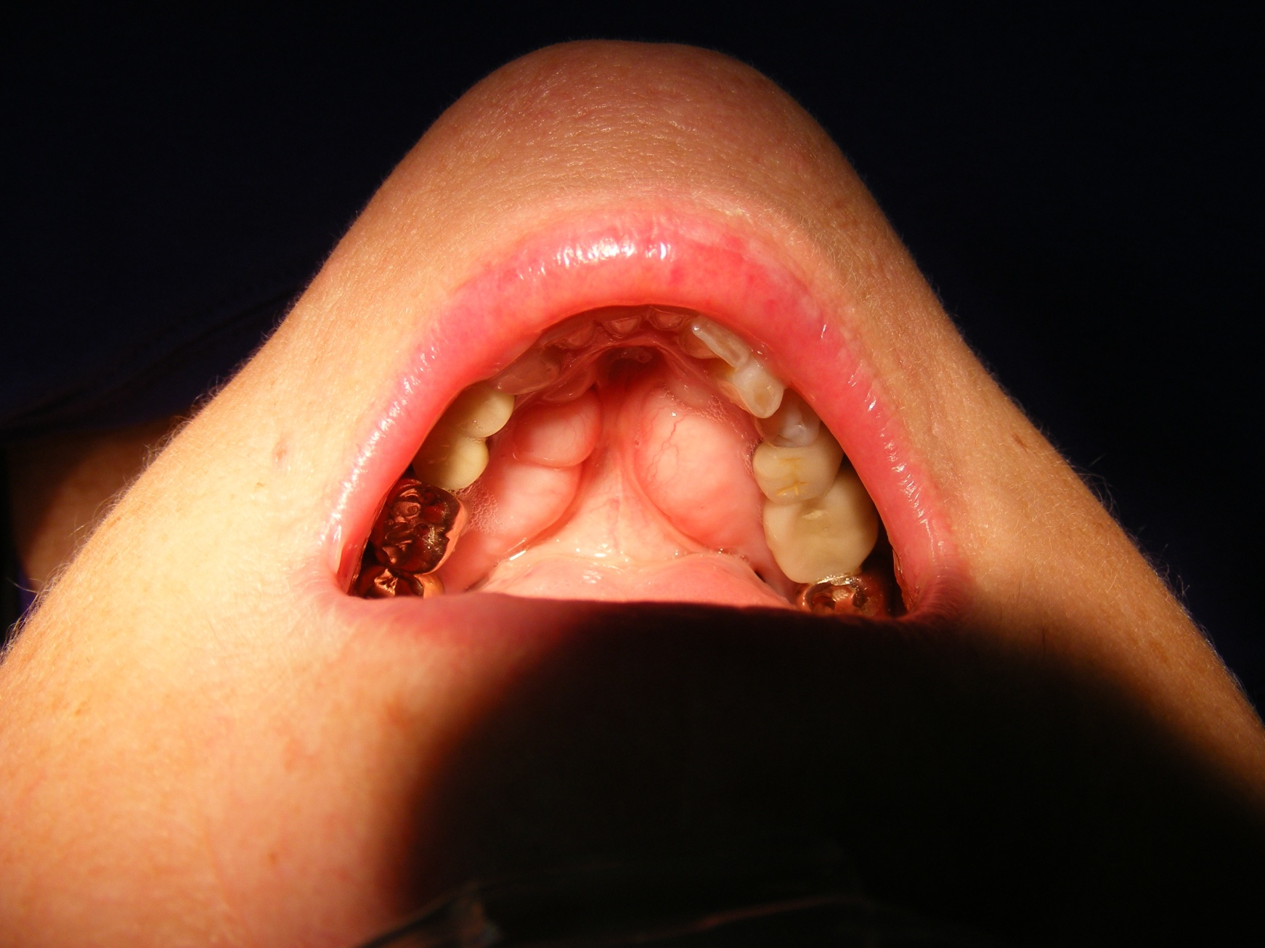
Preoperative

Slide 3
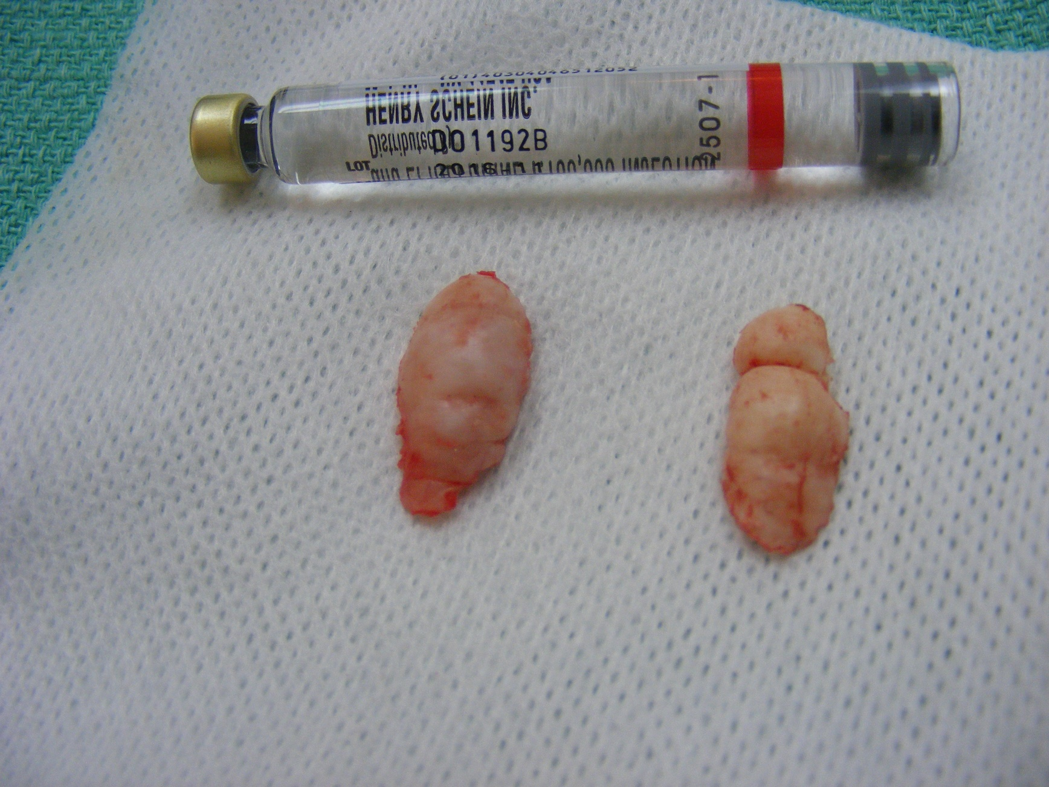
Specimen

Slide 4
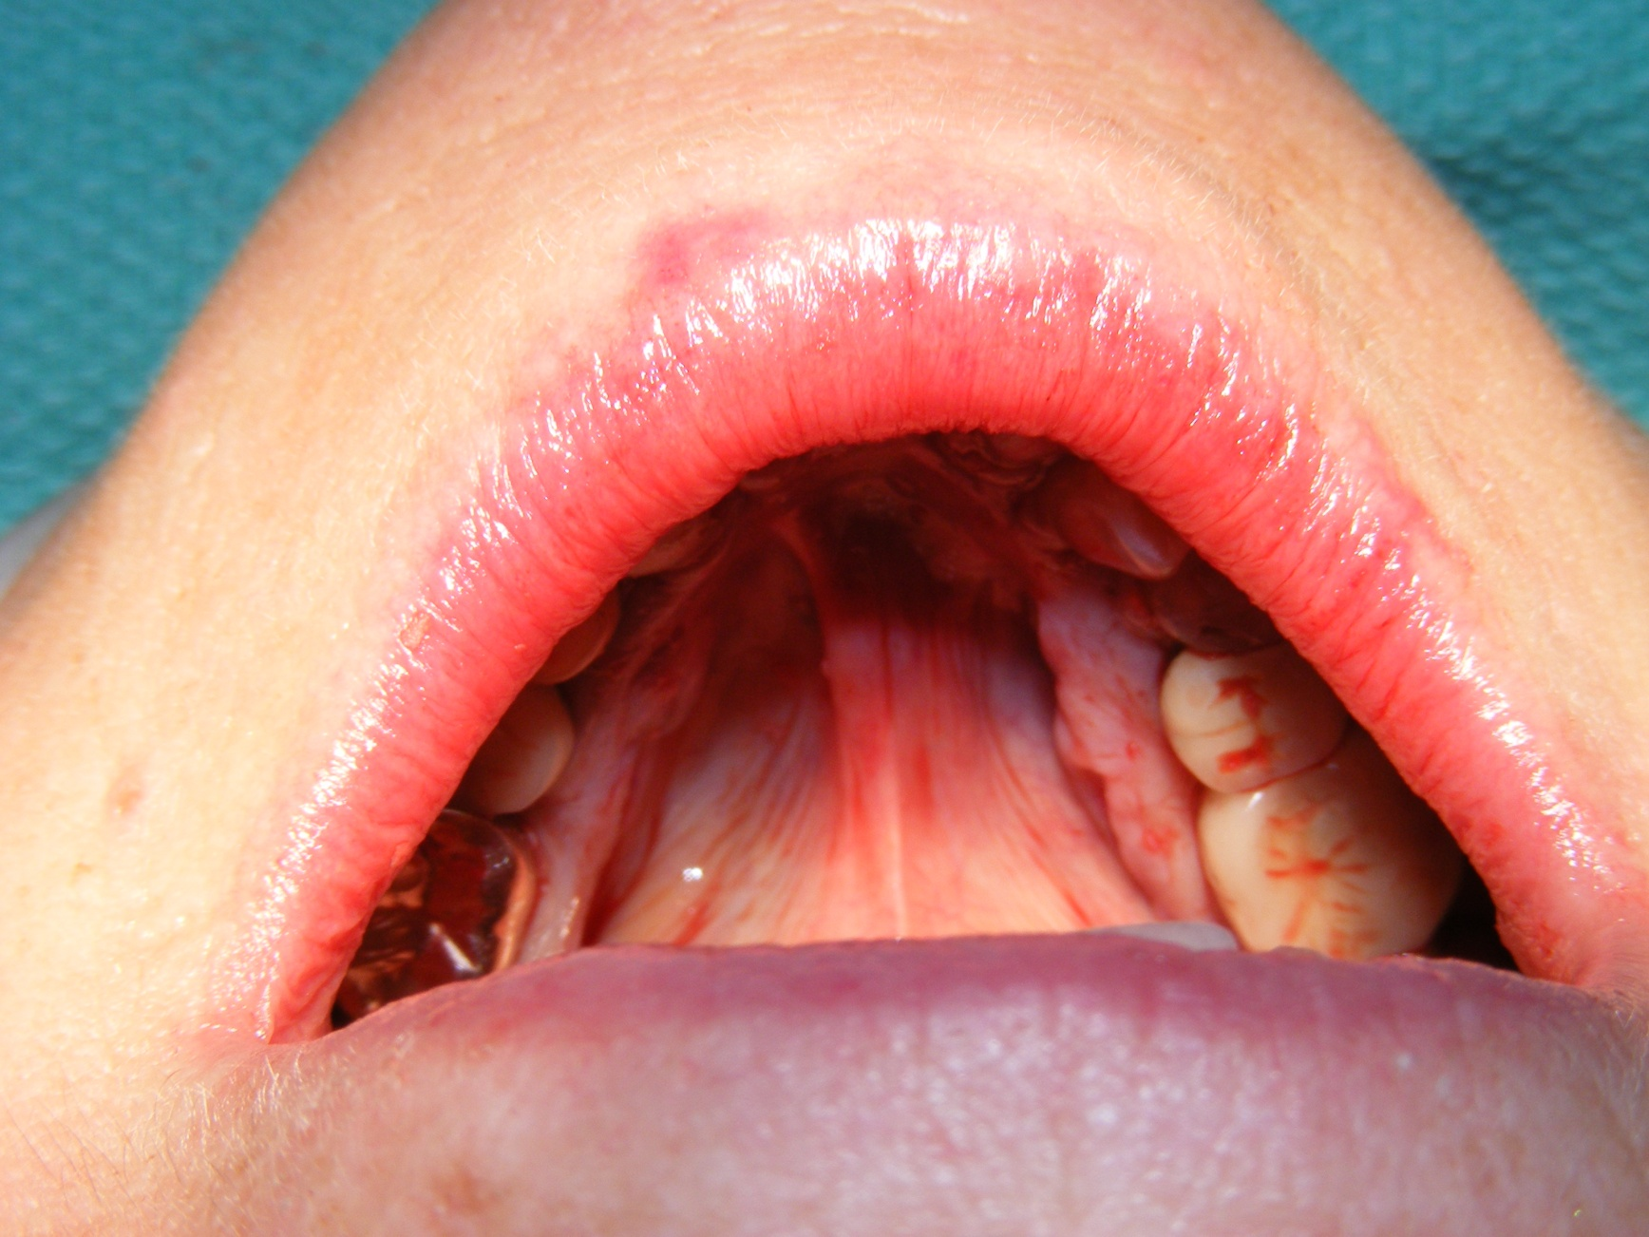
Immediately Postoperative

Slide 5
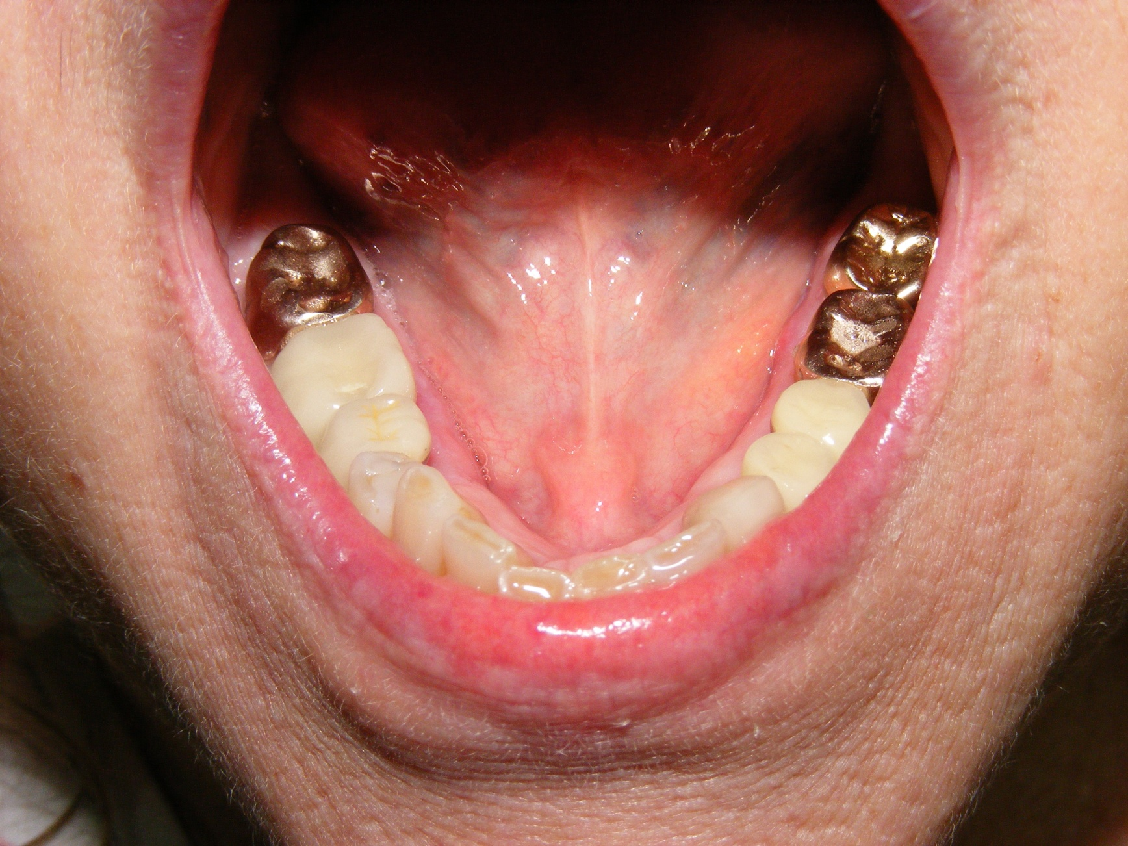
1 Month Postoperative

